Slide 1
WP4: Data Analysis Services Introduction
13 June 2029
Hans Fangohr, on behalf of WP4

Slide 2
Outline
Motivation and Objectives
Programme of Work (Tasks)
Re-usable remote data analysis
Status of remote data analysis services
Towards a unification of data analysis services
Relation to subsequent talks

Slide 3
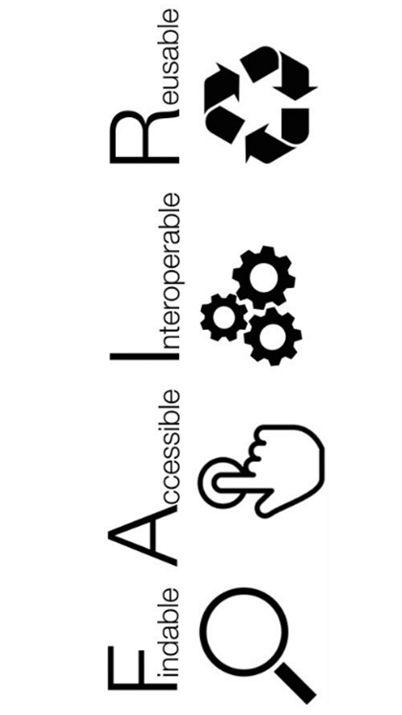
WP4 Motivation
Data analysis extracts meaning from data
Essential and non-trivial process in Photon and Neutron Science
Need software to process data
WP4 Objectives
Enable better reproducibility [1] and re-usability (faiR)
Control and execute data analysis remotely
Important for EOSC idea: data widely accessible (fAir)
Useful for facilities: data set size increasingly prohibits taking data home
COVID19: enable remote operation of facilities
[1] Reproducibility crisis, Nature 533, 452–454 (26 May 2016) doi:10.1038/533452a

Slide 4
Programme of work
Task 4.1: Survey (M1-13)
Submitted deliverable D4.1
Task 4.2 and 4.4 Remote Desktop & Jupyter based analysis services (M1-48)
Submitted deliverable D4.2
10:20 Demo (Thomas Vincent)
Task 4.3: Portal for remote data analysis (M13-36)
10:10 Demo (Jakub Grusz)
11:25 Talk (Jamie Hall)
Task 4.5: Deployment of remote analysis services at facilities (M12-48)
Submitted deliverable D4.2
Task 4.6: Demonstrator (M36-48)
See also technical report M18 for further details.

Slide 5
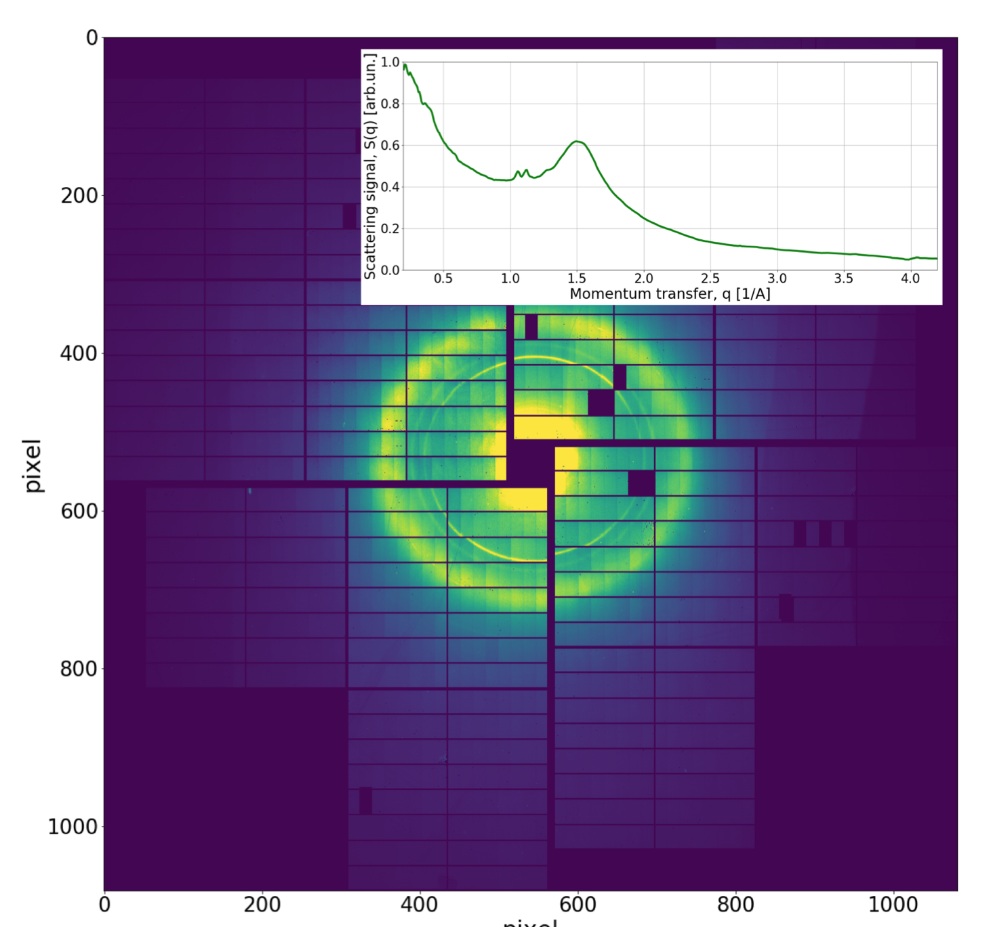
Towards re-usable remote data analysis
Ingredients
Data & Metadata
Data analysis procedure (scripts)
Data analysis software environment
Remote executability
Remote data analysis
SSH
Remote Desktop (VNC, FastX, VISA, NoMACHINE)
Jupyter Notebook (JupyterHub, BinderHub)

Slide 6
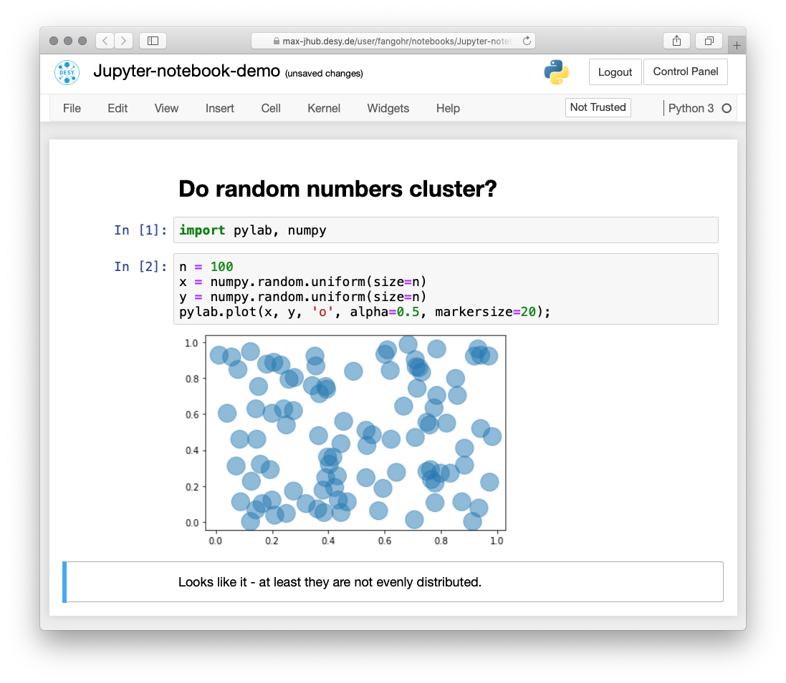
Jupyter
Architecture:
Computation takes place on machine in facility / cloud
Connect via https to user’s web browser
Discussion:
“Native web”
support for reproducibility
not for all use cases

Slide 7
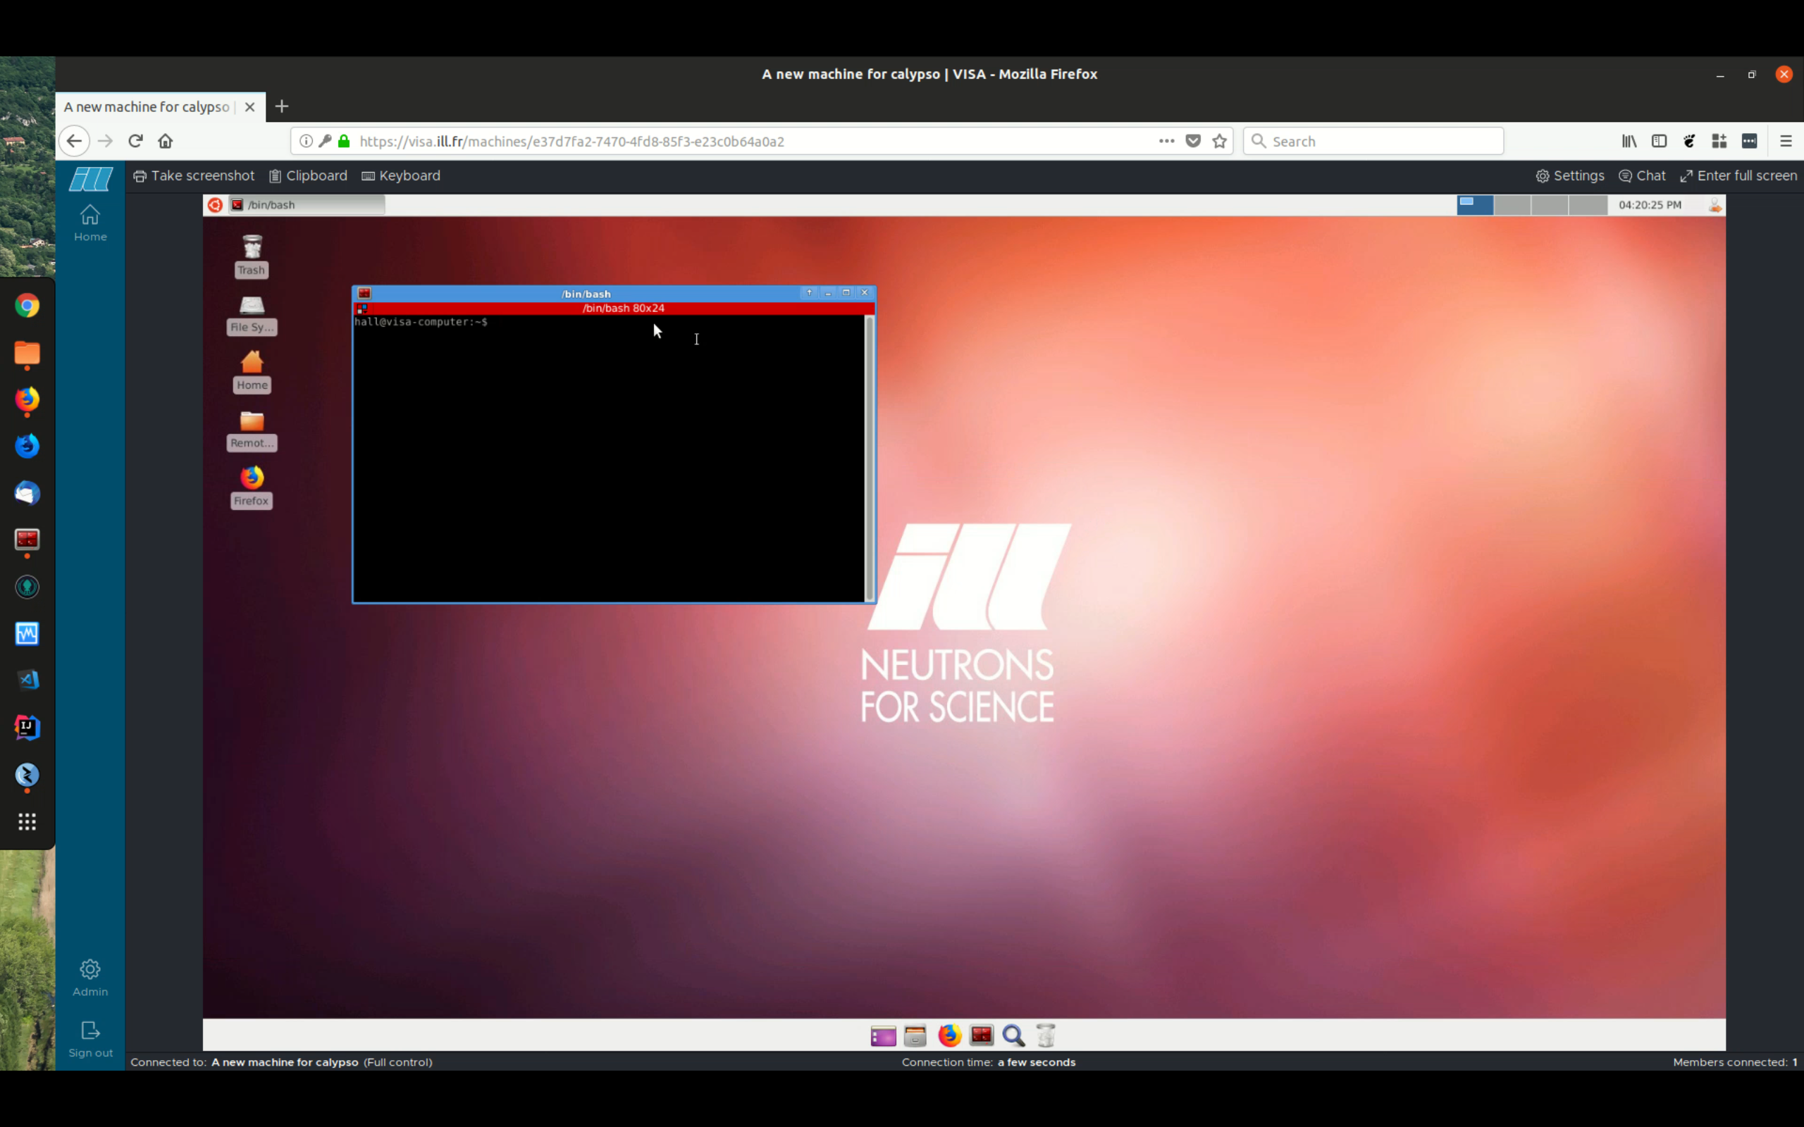
Remote desktop
Architecture
Computation takes place on machine in facility / cloud
Connect the machine’s graphical desktop to client in user’s web browser
Discussion
Can make any existing analysis environment available remotely

Slide 8
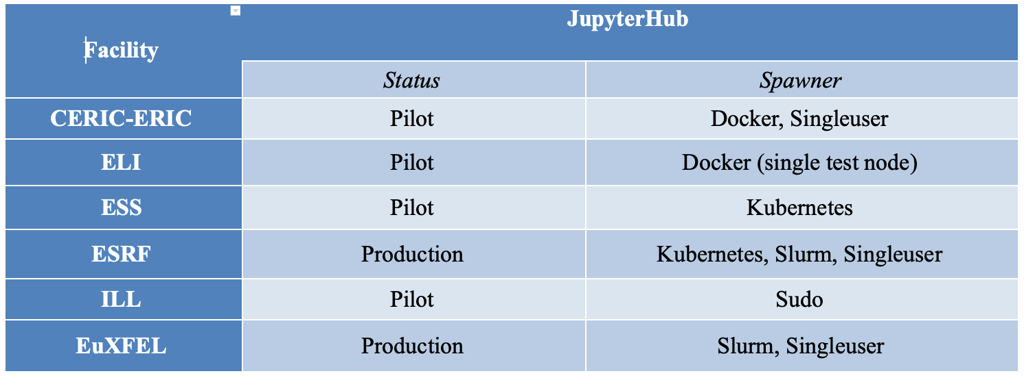
Status remote data Analysis: Jupyter

Slide 9
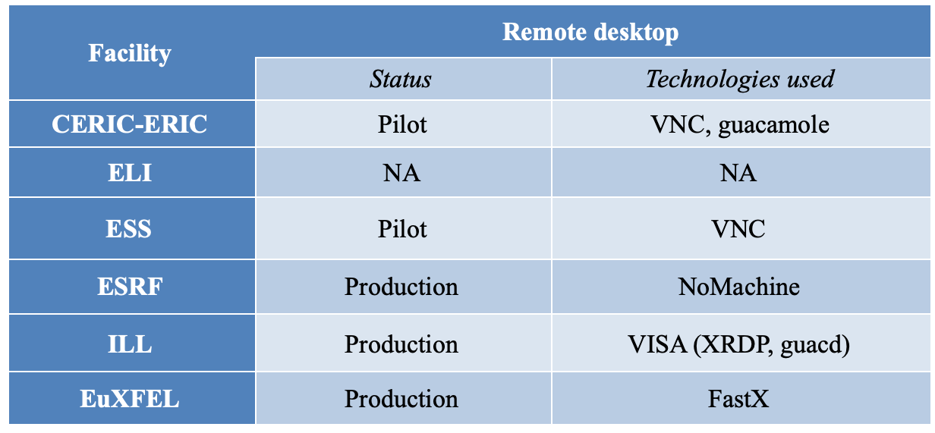
Status remote data Analysis: remote Desktop

Slide 10
Towards a unification of data analysis services
Constraints:
Established hardware and infrastructures at each site
Need useful user experience for sustainability
Strategy
Create common entry point (“Data search and analysis portal”) for each site as user interface
Portal translates request into local infrastructure
Potential to offer portal interface in EOSC

Slide 12
Programme today
10:10 Demo Portal (Jakub Grusz)
User experience Portal (mock-up)
Data finding, selection (mock-up), and triggering of analysis
10:20 Demo remote data analysis (Thomas Vincent)
Example data analysis
Remote analysis with Jupyter
Reproducible & re-usable work
11:25 Presentation Portal (Jamie Hall)
Architecture of Portal

Slide 13
Thank you
hans.fangohr@xfel.eu

Slide 14
Unused spare slides follow

Slide 15
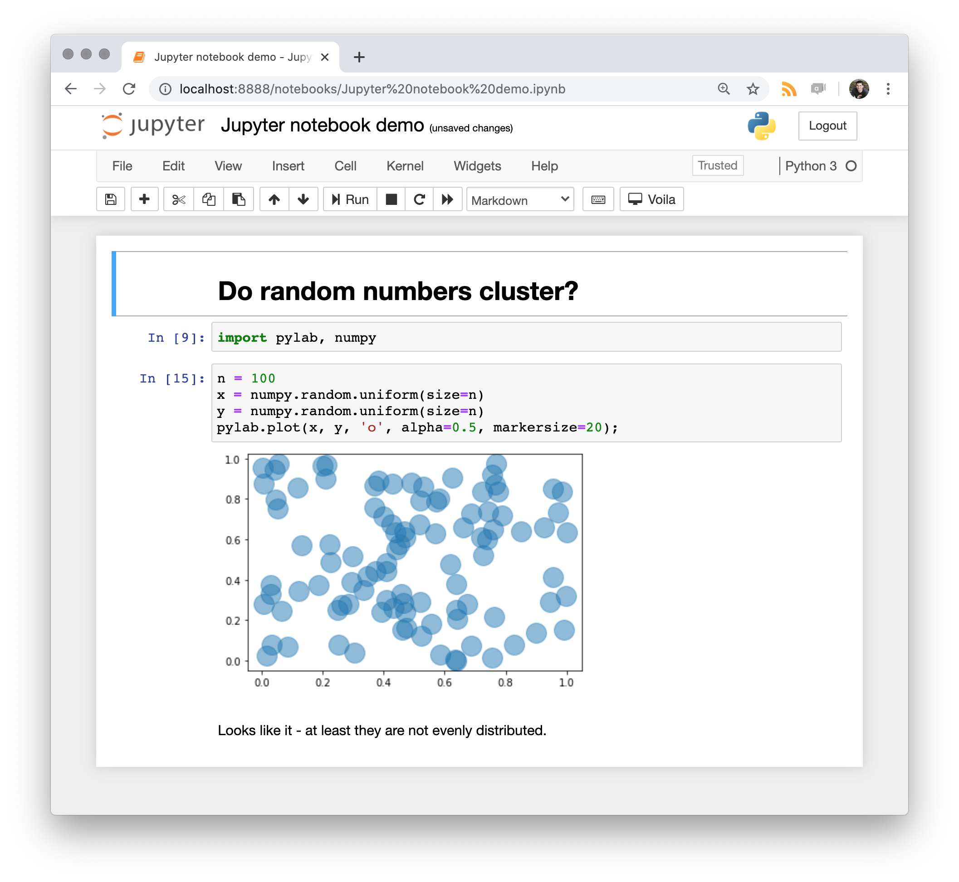
Remote data analysis technologies
Remote Desktop
Computation takes place on (virtual) machine in facility / cloud
Connect the machine’s graphical desktop to client in web browser
Jupyter
Computation takes place on machine in facility / cloud
Connect via https to client’s web browser

